Slide 1
Chapter 5: Dynamic Analysis-Test Design Techniques
Software Testing
White Box Testing

Slide 2
White Box Testing
Definition by ISTQB
White-box testing: Testing based on an analysis of the internal structure of the component or system.
White-box test design technique: Procedure to derive and/or select test cases based on an analysis of the internal structure of a component or system.
Test cases design:
Test cases are designed with the help of the program structure

Slide 3
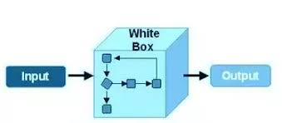
WHITE BOX TESTING
Also called Structured, clear box, open box. Glass box testing
Strategy in which testing is based on
- Structure
- Internal Paths
- Implementation
Goal is to verify working flow of an application.
Programming knowledge is essential.

Slide 4
Example
A tester, usually a developer as well, studies the implementation code
of a certain field on a webpage
Determines all legal (valid and invalid) AND illegal inputs
Verifies the outputs against the expected outcomes, which is also
determined by studying the implementation code.
WBT is like work of mechanic who examines the engine to see why the car is not moving

Slide 5
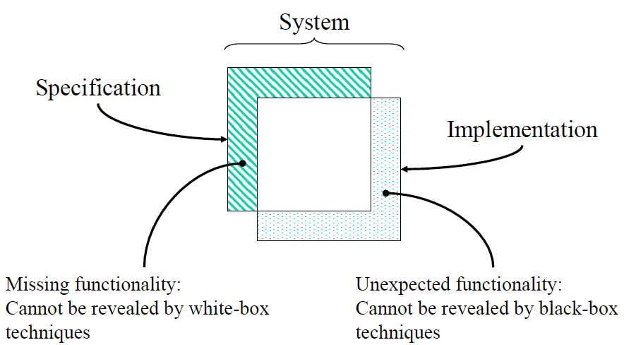
Black Box VS White Box

Slide 6
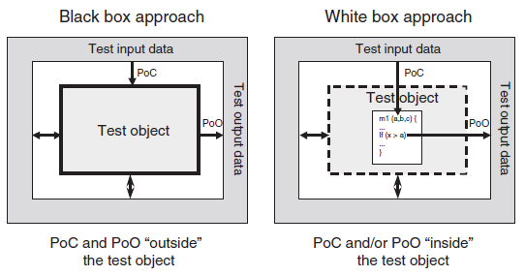
Black Box VS White Box
Black Box Example: Search something on google by using keywords.
White Box Example: By input to check and verify loops

Slide 7
White Box Testing - Applicability
It’s applicable to the following levels of software testing:
Unit Testing
- For testing paths within a unit.
Integration Testing
- For testing paths between units.
System Testing
- For testing paths between subsystems.

Slide 8
What do we verify in White Box Testing?
Internal security holes
Broken or poorly structured paths in the coding processes
The flow of specific inputs through the code
Expected output
The functionality of conditional loops
Testing of each statement, object and function on an individual basis

Slide 9
How do you perform White Box Testing?
Two steps to do:
1: Understand the source code
2: Create test cases and execute
Test cases are designed and selected based on code.
Why we perform WBT?
To ensure:
all independent paths
All logical decisions
All loops executed at their boundaries

Slide 10
White Box Testing Tools
Some of the prominent tools:
JUnit
Veracode
EclEmma
RCUNIT
Cfix
Googletest
EMMA

Slide 11
White Box Testing Techniques
Basis for WBT is source code.
Foundation of WBT is to execute every part of code at least once.
WBT coverage criteria is
- Covering all statements, branches, conditions etc
Different test cases => Different execution paths
Techniques are:
Statement Coverage Testing
Decision Coverage Testing
Condition Coverage Testing
Multiple Condition Testing
Path Coverage Testing
Data Flow Based Testing

Slide 12
Statement Coverage Testing:
Statement :
- 'An entity in a programming language, which is typically the smallest
indivisible unit of execution' (ISTQB Def).
Statement coverage:
- 'The percentage of executable statements that has been exercised by a
test suite‘. (ISTQB Def)
Test Coverage:
- Test coverage measures the amount of testing performed by a set of tests.
Coverage = (Number of coverage items exercised/Total number of coverage
items) * 100

Slide 13
White Box Testing Techniques
Statement Coverage Testing:
White box test design technique
Execute all or selected statements of the test object
Traverse all statements at least once
Covers only the true conditions.
What the source code is expected to do and what it should not.
Drawback of this technique is that we cannot test the false condition in it.

Slide 14
Statement Coverage Testing
Translate the source code into a control flow graph.
Statements are represented as nodes (circles)
Control flow between the statements is represented as edges
(connections).
Sequences of unconditional statements are illustrated as one single node
Unreachable code can be detected
Empty ELSE-parts are not considered

Slide 15

Statement Coverage Testing
Test Requirements= Statements in the program
*100
Test Completeness criteria (% of the statements in the software which were
executed atleast once)
How 100% statement coverage can be achieved?
Aim is to achieve the maximum amount of statement coverage with the minimum
number of test cases
In some situation one test case can also be enough
Statement coverage is also called C0- coverage/measure

